Slide 1

E-commerce Customer Analytics
Sales, Customer, Product & Marketing Performance Analysis
A Power BI based data analytics project using an e-commerce sales dataset.
TOOL
DASHBOARD
Power BI
Interactive
PROJECT TYPE
Data Analytics

Slide 2

1. Project Overview
Sales
Customers
Why this project?
Revenue, quantity and profit
Country and segments
• E-commerce businesses generate large volumes of customer, product and transaction data.
• Analytics helps convert this data into useful information for monitoring sales and customer behaviour.
• The project uses Power BI to organize the data into an interactive dashboard.
• The dashboard allows performance to be explored by product category, country, date, payment method and traffic source.
Products
Marketing
Category performance
Traffic sources
Interactive Dashboard
2

Slide 3
2. Project Objectives
01
Measure Overall Performance
02
Analyze Products
Track key indicators such as revenue, profit, quantity, tax and shipping cost.
Compare product categories using sales quantity, revenue and profit.
03
Understand Customers
04
Study Customer Journey
Explore customer distribution by country and identify customer segments.
Examine payment methods, traffic sources and returns.
3

Slide 4
3. Dataset & Data Model
Main data areas represented in the model
Product / Sales
Customer
Transaction
Product category
Quantity
Revenue
Profit
Discounted price
Tax
Shipping cost
Customer country
Traffic source
Return status
Customer attributes
Order date
Payment method
Order-level measures
Data preparation workflow
Dataset
→
Cleaning
→
Model
→
Measures
→
Visuals
→
Dashboard
4

Slide 5
4. Dashboard Design
KPI Cards
Product Analysis
Discounted price, profit, quantity and tax
Quantity and profit by product category
Customer Geography
Returns
Customer country and quantity distribution
Return rate across categories and time
Payment Analysis
Marketing Performance
Quantity by payment method
Revenue by traffic source
Interactive Filters
Category, country and order-date slicers
5

Slide 6
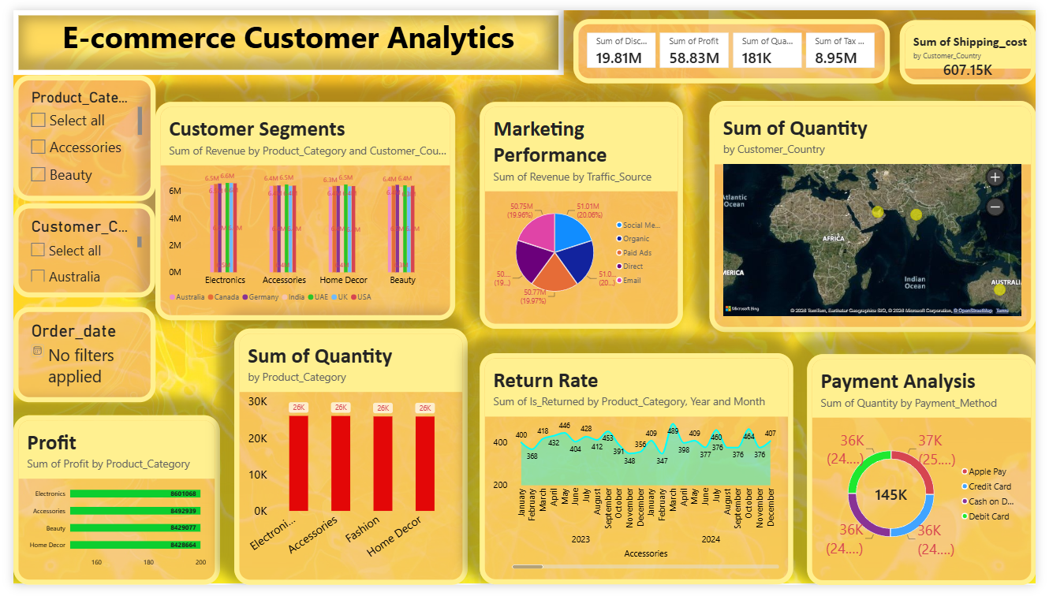
5. Dashboard
5

Slide 7
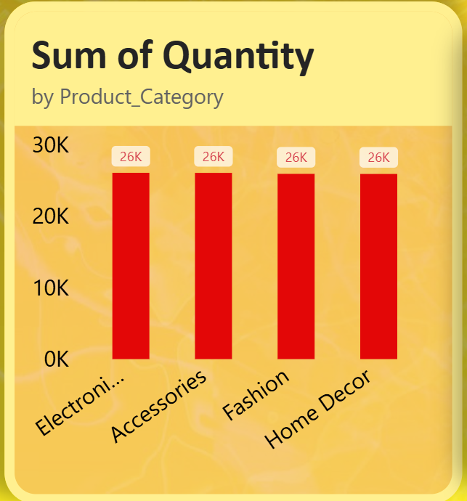
6. Sales & Product Analysis
What the dashboard examines
• Overall sales performance is summarized through revenue, profit, quantity, tax and shipping-related measures.
• Product categories can be compared using quantity sold and profit.
• The category-level views help identify differences in sales volume and profitability.
• Using category and date filters allows the same measures to be examined for a specific period or product group.
6

Slide 8
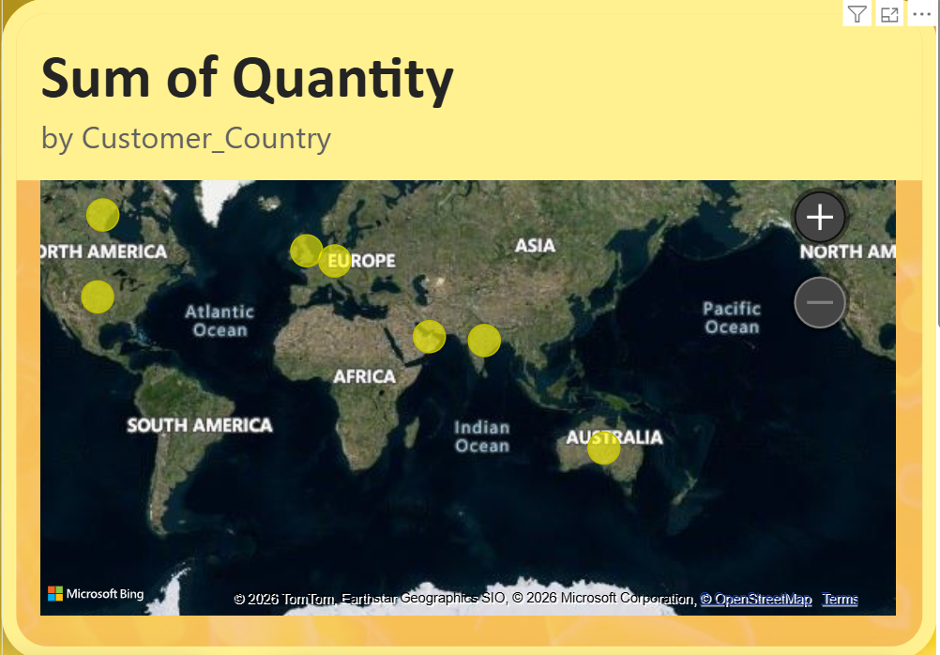
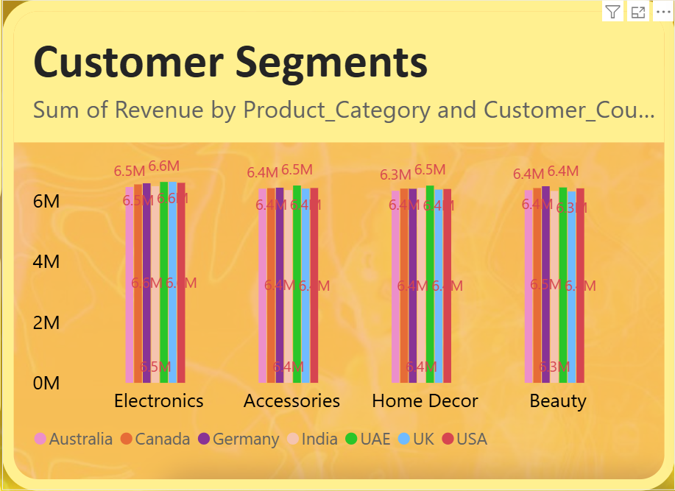
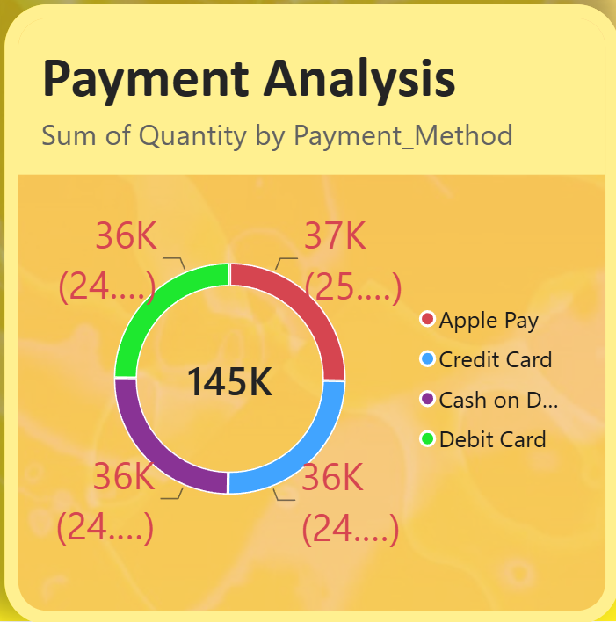
7. Customer & Payment Analysis
6

Slide 9
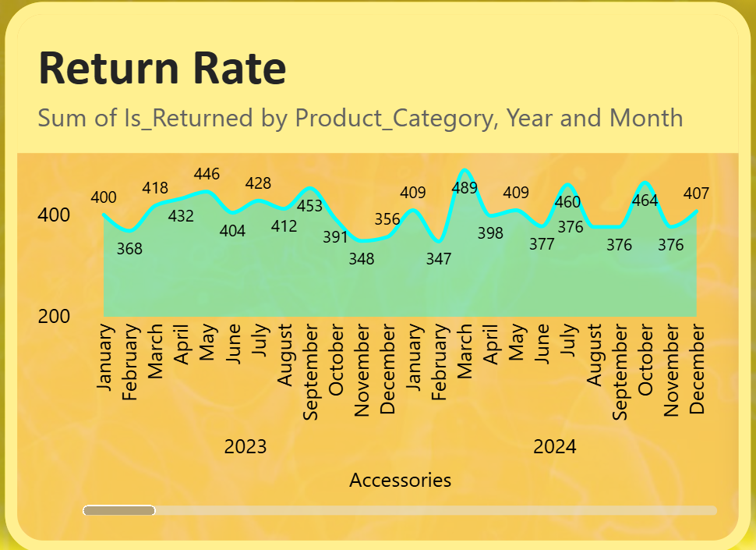
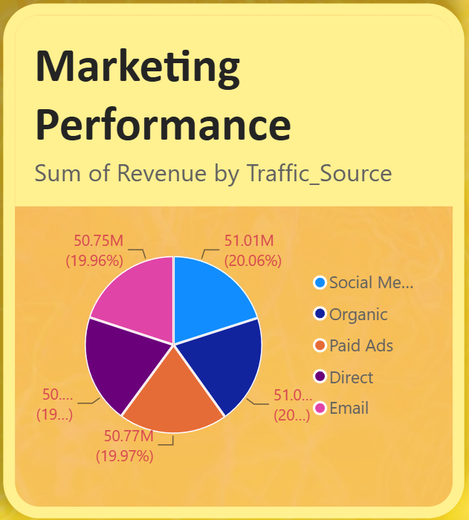
8. Returns & Marketing Analysis
Return analysis
Marketing performance
• The return-rate visual compares returned orders across product categories.
• The time hierarchy allows return behaviour to be examined by year and month.
• This can help identify categories or periods that require further investigation.
• Traffic source is linked with revenue to understand where sales originate.
• Comparing traffic sources provides a view of marketing channel contribution.
• The analysis can support future campaign and channel evaluation.
6

Slide 10
9. Key Findings
.
• Sales performance can be monitored from a single dashboard using multiple financial and operational KPIs.
• Product categories can show different patterns in sales quantity, revenue and profitability.
• Customer geography provides a clear way to compare activity across countries.
• Payment-method analysis helps describe how customers complete purchases.
• Return analysis adds an operational perspective by connecting product categories with returned orders over time.
• Traffic-source analysis connects marketing channels with revenue generation.
• Interactive slicers make it possible to investigate these patterns for selected categories, countries and time periods.
6

Slide 11
10. Conclusion
The E-commerce Customer Analytics dashboard brings together sales, product, customer, payment, return and marketing information in one interactive view. Power BI makes it easier to explore patterns and compare performance across categories, countries and time periods.
NEXT STEP
NEXT STEP
NEXT STEP
Validate Insights
Track KPIs
Improve Analysis
Project by Farhana Sultana, Rabin Das & Sanju Jana - Power BI Final Project |E-commerce Customer Analytics
6

